Slide 1
Simplification of CFG
Removal of Null Symbols
-- Sakshi Surve

Slide 2
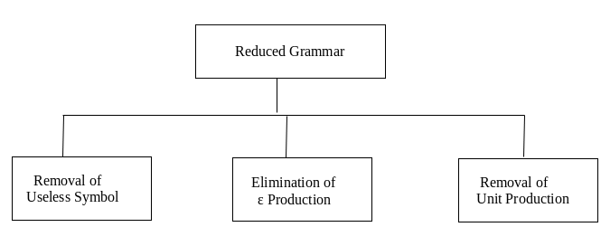
Three ways to Simplify the Grammar :

Slide 3
Removal of Null Symbols :
Null productions are of the form A -> ϵ.
In a given CFG, we call a non-terminal N nullable if there is a production N -> ϵ or there is a derivation that starts at N and leads to ϵ: N => … => ϵ.
We cannot remove all ϵ-productions from a grammar if the language contains ϵ as a word, but if it doesn’t we can remove all.
The removal of ϵ-productions increases the number of rules but reduces the length of derivations.

Slide 4
Steps to remove null productions :
Step 1: Look for the Null producions whose right side contains A
Step 2: Replace each occurrence of A in each of these productions with ϵ
Step 3: Now combine the result of step 2 with the original production and remove ε productions.

Slide 5
If A-> ϵ is a production to be eliminated, then we look for all productions , whose RHS contains A and replace every occurrence of A in each of these productions to obtain Non-ϵ-productions .
The resultant Non- ϵ-productions are added to the original grammar

Slide 6
Example 1 : S-> aA A-> b | ϵ Eliminate ϵ-productions from this grammar
Here, A-> ϵ is a Null Production.
By putting ϵ at the place of A, we get
S-> a
Now, adding this new production to the original grammar
S-> aA
S-> a
A-> b
OR
S-> aA | a
A-> b
This grammar doesn’t contain any ϵ-production

Slide 7
Example 2 : S-> aSa S-> bSb | ϵ Eliminate ϵ-productions from this grammar
Here, S-> ϵ is the epsilon production
So, replacing occurrence of S by epsilon , we get
S-> aa
S-> bb
Adding the new productions to the original grammar , we
get
S-> aSa | aa | bSb | bb

Slide 8
Example 3 : S -> aSb/aAb/ab/a A -> ε
Replace NULL producing symbol with and without in R.H.S. of remaining states And drop the productions which has ε directly.
eg. A -> ε
S -> aSb/aAb/ab/ab/a
But we no need to write "ab" twice So, S -> aSb/aAb/ab/a

Slide 9
Example 4: S -> AB A -> aAA/ε B -> bBB/ε
Nullale Variables are {A, B, S}
Because start state also a Nullable symbol so ε belongs to given CFG
We will proceed with the method:
S -> AB/A/B
A -> aAA/aA/a
B -> bAA/bB/b

Slide 10
Example 5 : Remove the null productions from the following grammar S -> ABAC A -> aA / ϵ B -> bB / ϵ C -> c
We have two null productions in the grammar A -> ϵ and B -> ϵ.
To eliminate A -> ϵ we have to change the productions containing A in the right side.
Those productions are S -> ABAC and A -> aA. So replacing each occurrence of A by ϵ, we get four new productions S -> ABC / BAC / BC A -> a Add these productions to the grammar and eliminate A -> ϵ. S -> ABAC / ABC / BAC / BC A -> aA / a B -> bB / ϵ C -> c

Slide 11
To eliminate B -> ϵ, we have to change the productions containing B on the right side of the newly generated grammar
Doing that we generate these new productions: S -> AAC / AC / C B -> b
Add these productions to the grammar and remove the production B -> ϵ from the grammar.
The new grammar after removal of ϵ – productions is:
S -> ABAC / ABC / BAC / BC / AAC / AC / C A -> aA / a B -> bB / b C -> c

Slide 12
Example 6 : Remove the production from the following CFG by preserving the meaning of it. S → XYX X → 0X | ε Y → 1Y | ε
Now, while removing ε production, we are deleting the rule X → ε and Y → ε. To preserve the meaning of CFG we are actually placing ε at the right-hand side whenever X and Y have appeared.
Let us take
S → XYX
If the first X at right-hand side is ε. Then
S → YX
Similarly if the last X in R.H.S. = ε. Then
S → XY

Slide 13
If Y = ε then
S → XX
If Y and X are ε then,
S → X
If both X are replaced by ε
S → Y
Now,
S → XY | YX | XX | X | Y | ε
Now let us consider
X → 0X
If we place ε at right-hand side for X then,
X → 0
X → 0X | 0

Slide 14
Similarly Y → 1Y | 1
Collectively we can rewrite the CFG with removed ε production as
S → XYX | XY | YX | XX | X | Y | ε
X → 0X | 0
Y → 1Y | 1

